Slide 1
DIGITAL PORTFOLIO
Name : PRAKASHRAJ C
REGISTER NO &NMID : 24131041802521027 & asanm10424cs38
DEPARTMENT : Bsc COMPUTER SCIENCE
COLLEGE : JAWAHAR SCIENCE COLLEGE

Slide 2
PROJECT TITLE :
SIMPLE VIDEO PLAYER

Slide 3
AJENDA
Problem Statement
Project Overview
End Users
Tools and Technologies
Portfolio design and Layout
Features and Functionality
Results and Screenshots
Conclusion

Slide 4
Problem Statement
The Challenge
Modern video players are often bloated with complex features that are not needed for basic video playback.
Users need a straightforward, clutter-free way to watch videos without navigating through confusing menus or settings.
This complexity leads to a poor user experience for people who simply want to play, pause, or fast-forward a video.

Slide 5
Project Overview
We've developed a simple video player designed for core functionality and ease of use.
The goal of this project is to provide a clean, intuitive interface for playing video files.
Our application removes unnecessary features to focus on a seamless and efficient viewing experience.

Slide 6
End Users
Casual viewers: People who want to quickly play a video without dealing with complex software.
Students and educators: Individuals who need to watch and review lectures or educational content.
Content creators: Developers or designers who need a lightweight tool to preview their video files.

Slide 7
Tools and Technologies
Our Tech Stack :
Frontend: HTML5, CSS3, JavaScript
Video API: The native HTML <video> element
Libraries: [List any specific libraries you used, e.g., video.js, a specific UI framework]
Deployment: [Where did you host it, e.g., GitHub Pages, Netlify]

Slide 8
Portfolio design and Layout
User-Centric Design :
Minimalist Aesthetic: The design is clean and unobtrusive, allowing the video to be the main focus.
Key Components: The video viewport, a play/pause button, a timeline/seek bar, and a volume control.
Intuitive Layout: The controls are simple and accessible, placed in a standard layout that users are already familiar with.

Slide 9
Features and Functionality
Core Features :
Video Playback: Plays standard video formats like MP4.
Play/Pause Controls: A toggle button to start and stop the video.
Seek Bar: Allows users to easily jump to any point in the video's timeline.
Volume Control: A slider to adjust the audio level.
Full-Screen Mode: An option to expand the video to fill the entire screen.

Slide 10
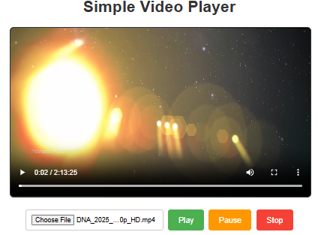
Results and Screenshots

Slide 11
Conclusion
We successfully developed a simple, reliable video player that puts the user experience first.
Potential Future Improvements:
Add support for a wider range of video formats.
Implement a subtitle or closed captioning feature.
Add a "dark mode" for better viewing in low-light environments.

